Slide 1


Day Two: Advanced Graphics
Dr Ben Dickins
School of Science and Technology
Tuesday 12th September 2017

Slide 2
Outline
Installations:
Installing packages for later
Data wrangling in R:
Types of objects
Aggregation methods
Attaching/detaching datasets
An Introduction to the tidyverse.
Base package {advanced graphics}:
Types of graphical functions
Inspecting/attaching a dataset
Barcharts: simple to advanced
The ggplot2 package:
The grammar of graphics
Examples
Interactive graphics {in html}:
Introduction to Shiny

Slide 3
Time Sinks
We can front-load some time consuming steps now…

Slide 4
Downloading Data for Today
Visit my Github repo here:
https://github.com/tethig/render
Click “Clone or Download”…
… and select “Download ZIP”.
Unzip the folder “render-master” …
… and put it on your Desktop …
… or somewhere accessible.

Slide 5
Package Installation
Packages contain additional functions and should be maintained with strict versioning. The tidyverse is a metapackage (a family of packages) and you can find out more about it here.
Do it yourself:
> install.packages('tidyverse') ↵
> install.packages(c('gplots', 'vioplot'))↵
> install.packages('shiny') ↵
You only need to install a package once on your own computer. But before we use each (meta)package we will load it into memory for each session using the library() function.
Let me show you how to do this using the RStudio interface!

Slide 6
Basic data wrangling in R
re-organising data for analysis

Slide 7
Vector Refresher and Shortcuts
Do it yourself: vector shortcuts:
> c(3,4,5,6,7,8) ↵
# the c() function concatenates anything (including other vectors)
> 3:8 ↵
# the `:` is a shortcut to give you all the integers in between
> 1:5*2 ↵
# multiplying each number by 2 gives you different spacing
> seq(2,10, by=2) ↵
# the equivalent using seq() function
> rep(3:8, times=2)↵
# the rep() function repeats a vector `times` times
> rep(3:8, each=2)↵
# or you can repeat the elements (try both if you want)

Slide 8
Refresher: Types of Object
Do it yourself: Let’s make some objects:
> NumV <- 1:20 ↵
> FacV <- factor(rep(letters[1:5], each=4)) ↵
> SecondV <- rbinom(n=16, size=100, prob=.5) ↵
> M <- matrix(SecondV, nrow=4, ncol=4) ↵
> L <- list(a=1, b=1:3, c=10:100) ↵
Now take a look at these objects. What types of objects are they? Use str(object) to help you.
Not sure what letters() and rbinom() are doing? Take a look at those parts of the code.
Factors are important in analysis.

Slide 9
Subsetting Objects
Do it yourself: Take subsets of letters
> letters[c(2:4,26)] ↵
# can you make sense of this?
Now take subsets of the matrix we just made:
> M[2,3] ↵
> M[2,] ↵
> M[,3] ↵
> M[2,2:4] ↵
# can you make sense of these?
This also works with data frames and their tidyverse cousins: `tibbles`.

Slide 10
Base Aggregation Functions (*apply)
Function | Mnenomic | What it does | Example (Try them!)
apply() | -- | apply “function” to rows OR columns of a matrix | apply(M, 1, min) apply(M, 2, max)
lapply() | list | apply function to each element in a list and emit list | lapply(L, FUN = length) lapply(L, FUN = sum)
sapply() | simplifying | apply function to each element in list and output list | sapply(L, FUN = length) sapply(L, FUN = sum)
tapply() | per type | apply function to subsets of a vector (defined by other vector) | tapply(NumV, FacV, sum)
by() | by column | apply to subsets of columns in a data frame (defined by vector) | by(warpbreaks[,1:2], tension, summary)
aggregate() | -- | equivalent to by() but outputs to a new data frame | aggregate(breaks, list(wool, tension), summary)
Notes:
Acknowledgement: Reworked from Joran’s answer here: http://tinyurl.com/omrhtm7

Slide 11
Attaching a Dataset
Do it yourself: Many datasets are available:
> library(help = "datasets") ↵
Let’s get one of them and find out about it:
> data(warpbreaks)↵
> ?warpbreaks ↵
> View(warpbreaks)
and then attach the data to memory:
> attach(warpbreaks)↵
This means that variable names will be remembered.

Slide 12
Advanced Aggregation
Function | Mnenomic | What it does | Example (Try them!)
apply() | -- | apply “function” to rows OR columns of a matrix | apply(M, 1, min) apply(M, 2, max)
lapply() | list | apply function to each element in a list and emit list | lapply(L, FUN = length) lapply(L, FUN = sum)
sapply() | simplifying | apply function to each element in list and output list | sapply(L, FUN = length) sapply(L, FUN = sum)
tapply() | per type | apply function to subsets of a vector (defined by other vector) | tapply(NumV, FacV, sum)
by() | by column | apply to subsets of columns in a data frame (defined by vector) | by(warpbreaks[,1:2], tension, summary)
aggregate() | -- | equivalent to by() but outputs to a new data frame | aggregate(breaks, list(wool, tension), summary)
Notes:
Acknowledgement: Reworked from Joran’s answer here: http://tinyurl.com/omrhtm7

Slide 13
Detaching a Dataset
Always do it !
> detach(warpbreaks)↵
This means that variable names will be forgotten.
How do we refer to columns is detached objects?
The old-fashioned way:
> warpbreaks[,3] ↵
By column header using $ notation (very useful!):
> warpbreaks$tension ↵

Slide 14
Welcome to the tidyverse
…a comparison with the base package

Slide 15
Loading from File with Base Package
Do it yourself:
> arctic_df <- read.csv("NOAA_Arctic.csv") ↵
What went wrong? Go look at the file.
Take a look at the CSV file using a text editor. What do you see?
Now try:
> arctic_df <- read.csv("NOAA_Arctic.csv", comment.char = "#")↵
Other useful arguments are skip and header.

Slide 16
Loading from File with tidyverse
First load the library (if tidyverse not loaded):
> library(tidyverse) ↵
We might have loaded just the `readr` package but here we load all the tidyverse metapackage. Now let’s use readr to load the data into a `tibble`:
Do it yourself:
> arctic <- read_csv("NOAA_Arctic.csv", comment = "#")↵
Notice the different arguments.
So what? Look carefully at the column names. Notice the use of `` around `complex column names`.

Slide 17
The dplyr paradigm 1
Now we can do several things to the tibble (using dplyr, also in the tidyverse):
Do it yourself:
> filter(arctic, Month==1, Day==1)↵
> filter(arctic, `Extent (10^6 sq km)`<=3.5) ↵
Notice the different arguments.
Here you are selecting rows based on values. It is also possible to use & (for AND) and | (for OR) queries.

Slide 18
The dplyr paradigm 2
Do it yourself: let’s tame the lengthy variable name:
> arctic <- rename(arctic, Extent=`Extent (10^6 sq km)`) ↵
Now let’s try these:
> select(arctic, Year) ↵
# equivalent to arctic$Year
> select(arctic, Year:Day)
Now make a new variable:
> mutate(arctic, logex=log(Extent))
# what happens if you use transmute instead of mutate?

Slide 19
Summarising Data 1
Summarise¹ can be used to convert to a single row:
> summarise(arctic, area=min(Extent)) ↵
More useful if you can group the data:
> by_year <- group_by(arctic, Year)↵
# go take a look at this object:
> by_year ↵
# doesn’t look very interesting – but let’s summarise that instead
> min_ice <- summarise(by_year,area=min(Extent))
# now what’s happened?
> min_ice ↵
We are making a lot of intermediate objects here and having to inspect them
¹ yes UK spelling here – tidyverse author is from New Zealand…

Slide 20
Summarising Data 2
Let’s do this slightly differently:
> ( max_ice <- summarise(by_year,area=max(Extent)) ) ↵
Wrapping an assignment in outer brackets prints output to the screen as well as assigning.
So we can also look at it whenever we wish:
> max_ice ↵
But we are still working with intermediate objects. That could get untidy.

Slide 21
Piping Data
Using pipes:
> ( lean_yrs <- arctic %>% ↵
+ group_by(Year) %>% ↵
+ summarise(area=min(Extent)) %>% ↵
+ filter(area < 5) ) ↵
Using pipes enables you to skip references and pass your analyses on for further processing.
In this example, we piped from line to line but you can enter all in one line.

Slide 22
enough already give me a graph!
So, I highly recommend consulting R for Data Science, in particular: chapters 5 and 12
but…
Ok, but then we’ll have to go slow again…

Slide 23
All on one slide!
Using ggplot2 (part of tidyverse):
library(lubridate)
arctic %>%
mutate(Date2=make_datetime(Year, Month, Day)) %>%
mutate(DayinYear=as.numeric(format(Date2, "%j"))) %>%
ggplot(aes(x=DayinYear, y=Extent, colour=Year)) +
geom_point()
But we’ll come back to this package later…

Slide 24
Patience: Base package graphics
advanced plots in the base package

Slide 25
Graphical Functions
Two types of plotting function in the base package:
high-level, e.g., plot(),boxplot(),image()
low-level, e.g., title(), points(),abline()
In general, modularity is good, meaning use low level function to decorate plots.
Let’s start with something familiar - the “mtcars” dataset.

Slide 26
An Old Favourite
Do it yourself: Get it into the memory:
> attach(mtcars)
Refresh yours!
> mtcars ↵
> ?mtcars↵
> View(mtcars)↵
> str(mtcars)↵
> plot(mtcars)↵
Notice how insane the plot() function can be = all against all. Let’s make things behave properly.

Slide 27
Bar Charts and Aggregating Counts
We can use barplot for plotting counts (in which both the x and y variable are categorical).
Do it yourself: Construct a barplot for number of gears in mtcars data set:
> gear ↵
> counts <- table(gear) ↵
Yes, `table()` tabulates count data = cool…
> counts↵
> barplot(counts)↵
That looks alright, but a bit simple…

Slide 28
Elaborating Plots
Do it yourself: plot the density of the counts:
> barplot(counts/length(gear), names.arg=c("three","four","five")) ↵
and now label our plot:
> title(main="Car Distribution", xlab="Number of Gears", ylab="Relative Frequency")↵
We wrote decorative text using a low level function.

Slide 29
Bar Charts with Point Estimates
We can use barplot for point estimates of a continuous y variable; we need an *apply function.
Do it yourself: calculate the mean mpg rating for cars with different numbers of gears:
> heights <- tapply(mpg, gear, mean)↵
and now plot and label these:
> barplot(heights)↵
> title(main="Mean Efficiency", xlab="Number of Gears", ylab="Miles per Gallon")

Slide 30
Confidence Intervals
We can also plot error bars. For this we need an extra library*.
Do it yourself: install and then load the package gplots:
> install.packages('gplots')↵
> library(gplots)↵
This package contains an enhanced version of the barplot() function called barplot2().
* it is also possible to plot error bars with the base package + the low-level function arrows().
Notes:
For an example of the use of the arrows() function see: http://stackoverflow.com/a/22037078

Slide 31
Confidence Intervals
Do it yourself: here we exploit summary stats produced by the t.test() function*:
> lower <- tapply(mpg, gear, function(i) t.test(i)$conf.int[1]) ↵
> upper <- tapply(mpg, gear, function(i) t.test(i)$conf.int[2])↵
Plot the graph and decorate:
> barplot2(heights, plot.ci=TRUE, ci.l=lower, ci.u=upper, ci.width=0.2)↵
> title(main="Car Efficiency", xlab="Number of Gears", ylab="Miles per Gallon")↵
Notes:
Acknowledgement: Teetor, P. (2011). R cookbook. O'Reilly Media, Inc. Chapter 10, p238 – this includes details on curtailing the y axis. I prefer to avoid this practice when possible, but the recipe is excellent.

Slide 32
Multiple Predictors
Do it yourself: Construct a barplot for number of gears in mtcars data set grouped by vs:
> counts <- table(vs,gear) ↵
> barplot(counts, col=c("lightblue","mistyrose"), legend=T, args.legend=list(title="vs")) ↵
> title(main="Car Distribution by Gears and VS", xlab="Number of Gears") ↵
Try adding beside=TRUE as an argument to the barplot() call. What happens?

Slide 33
Distribution Plots: Boxplot
You can use boxplot() to get an idea of the distribution of y ~ (as affected by) x with an intuitive model formula.
Do it yourself
> boxplot(mpg ~ am, names=c("Automatic", "Manual")) ↵
> title(main="Boxplot Showing Distribution", xlab="Transmission", ylab="Miles per US Gallon") ↵
Something like tapply() is happening behind the scenes.

Slide 34

Warning!!!
Do it yourself This is what happens when you pass variables without the model notation:
> boxplot(am, mpg, names=c("all am value", "all mpg values"))↵
So there’s nothing wrong with passing vectors to boxplot(), but don’t expect tapply() behaviour unless you use ~ notation.

Slide 35
Distribution Plots: Violin Plots
A nice alternative is vioplot():
Do it yourself
Start by installing and loading the required library:
> install.packages('vioplot')↵
> library(vioplot)↵

Slide 36
Subsetting Data
The `subset()` function helps to split a variable/vector using a factor:
Do it yourself: Get subsets of data:
> auto <- subset(mpg, am==0, data=mtcars)↵
> man <- subset(mpg, am==1, data=mtcars) ↵
See my notes for the tidyverse approach to this (which I prefer).

Slide 37
Violin Plots
Now we can try a violin plot:
But be careful – this does not support the formula notation hence the need for vector splitting…
Do it yourself: Now we can plot:
> vioplot(auto, man, names=c("Automatic", "Manual")) ↵
> title(main="Violin Plot", xlab="Transmission", ylab="Miles per US Gallon")↵
Notes:
http://www.r-bloggers.com/overlapping-histogram-in-r/

Slide 38
Distribution Plots: Histograms
Do it yourself: Let’s compare distributions:
> hist(auto, col=rgb(1,0,0,0.5), breaks=seq(10,36,2), xlim=c(10,35), ylim=c(0,5), main="", xlab="") ↵
> hist(man, col=rgb(0,0,1,0.5), breaks=seq(10,36,2), add=T) ↵
Decorate:
> title(main="Double Histogram", xlab="Miles per Gallon") ↵
> legend("topright", c("automatic","manual"), fill=c(rgb(1,0,0,0.5),rgb(0,0,1,0.5)))↵
Notes:
http://www.r-bloggers.com/overlapping-histogram-in-r/

Slide 39
Advanced Boxplots (base)
The formula notation in boxplot supports interrogation of multiple predictors.
Do it yourself: We can plot by two categorical predictors using boxplot too.
> boxplot(mpg~vs*am, data=mtcars, col=(c("mistyrose","lightblue")))
> title(main="Car Engines", xlab="Config * Transmission", ylab="Miles per gallon") ↵
Try adding a notch=TRUE argument to the plot call.
I’ll leave further decoration to you…

Slide 40
Quick Alternative Plot
Quick plot with two predictors
Do it yourself: We can plot miles per gallon (mpg) grouped by # of gears (gear) and engine config (vs)
> interaction.plot(mtcars$gear, mtcars$vs, mtcars$mpg) ↵
mtcars$vs is used as a tracing factor here

Slide 41
Cleaning Up
Do it yourself Detach from the dataset
> detach(mtcars)↵
You can also clean up variables:
> rm(auto, man)↵
> rm(list=ls()) ↵
Using rm() is playing with fire!

Slide 42
Controlling Graphical Parameters
A microarray with minimal data…
Do it yourself: Here we load some data from a file:
> setwd('~/Desktop/render-master') ↵
> array <- read.csv('heatmaps_in_r.csv', header = TRUE, comment.char="#", row.names = 1) ↵
We reset some graphical parameters and make our heatmap:
> op <- par(cex.axis=0.6, las=2) ↵
> image(x=1:10, y=1:4, z=data.matrix(array), col=rev(heat.colors(10)), xlab='', ylab='') ↵
> hist(rnorm(100)) ↵
Data adapted from http://www.sbeams.org/sample_data/ [accessed 07/05/2015]

Slide 43
Controlling Graphics
Do it yourself: Reset graphics back to original:
> par(op) ↵
> hist(rnorm(100))↵
Now you can nerd out with graphical parameters:
> ?par ↵
> ?points↵
> ?colours ↵
> ?image↵
Take home: parameters can be set and reset within each device. Meaning…

Slide 44
Writing to a Device
Do it yourself: Now let’s get serious with graphics parameters and plotting devices:
> pdf("nanoarray.pdf", 12, 6) ↵
> par(cex.axis=0.6, las=2) ↵
> image(x=1:10, y=1:4, z=data.matrix(array), col=rev(heat.colors(10)), xlab='', ylab='', axes=F) ↵
> axis(1, at=1:10, labels=rownames(array)) ↵
> axis(2, at=1:4, labels=colnames(array)) ↵
> title(xlab="sample", ylab="probe", cex.main=2) ↵
> dev.off() ↵

Slide 45
Using source() to run all lines in script
There is a script called makearray.R in the render-master folder:
What has this script done?
Hints:
Look in the folder again for new files
Open the script using RStudio or a text editor
Can you see any new objects in memory?
Do it yourself: run this script:
> source('makearray.R') ↵

Slide 46
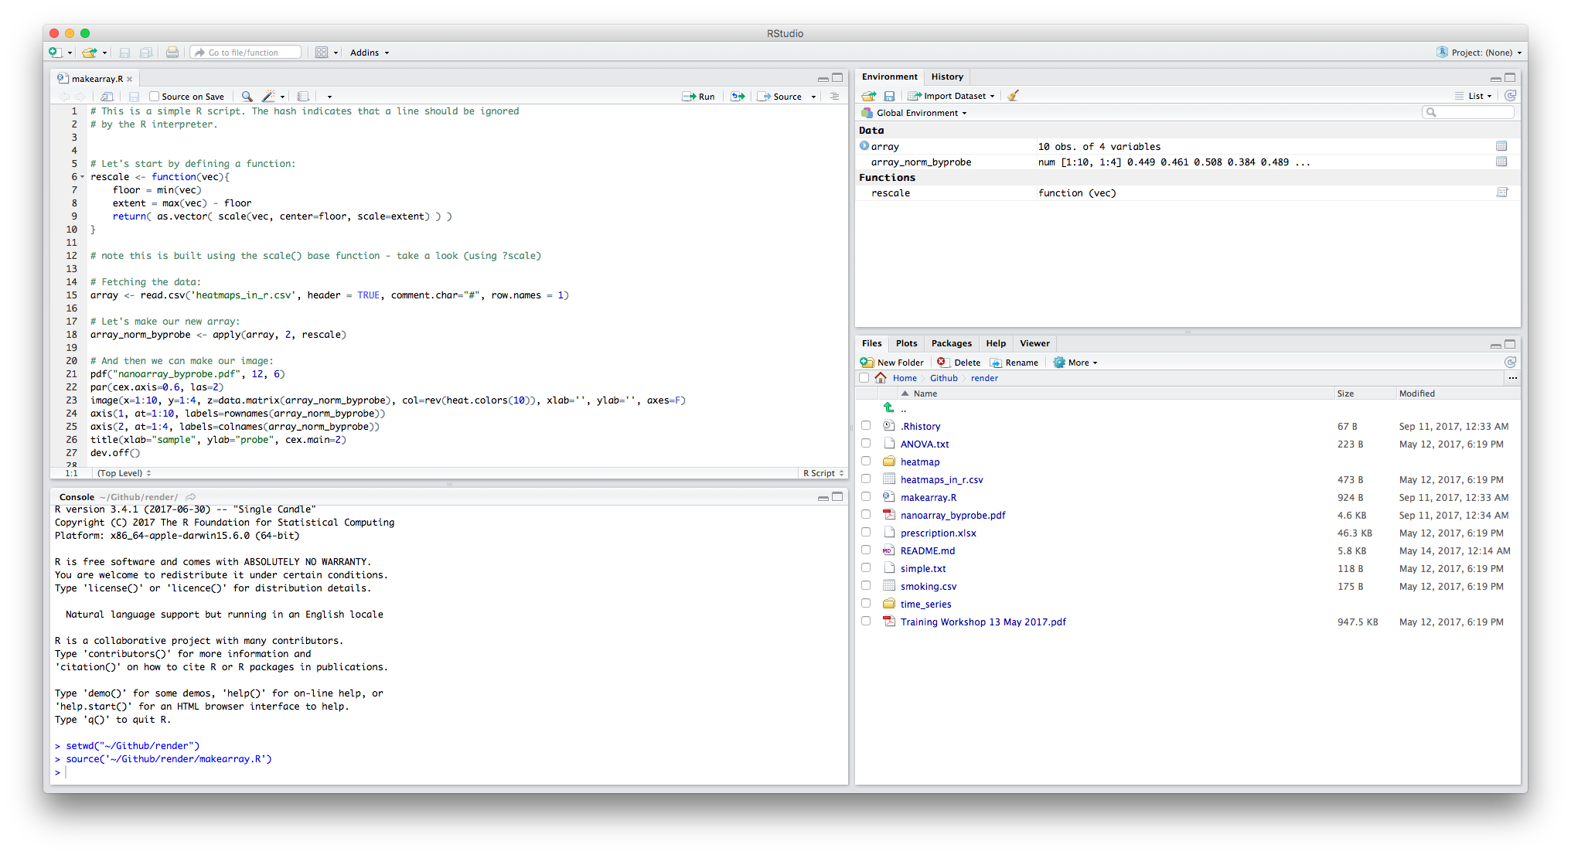
In RStudio’s Environment

Slide 47
ggplot2: grammar of graphics
made by a kiwi

Slide 48
Grammar of Graphics (ggplot2)
Data: This comprises variables that we wish to represent (the relations between).
Geoms: Geometrical objects such as bars in a barchart will represent the data.
Aesthetics: These will determine how geoms are drawn
A point’s position or a histogram bar’s shape
Mappings: from data to aesthetics
relates a data value to a point’s position
Scales: will determine how mapping work
a larger values makes a taller bar
Guides: will assist the reader to understand the mappings.
tick marks and labels on an axis
we must add them all together

Slide 49
ggplot2
Do it yourself: here we exploit the aggregation abilities of the plyr package to create a summary dataframe:
# install.packages('ggplot2') ↵
# library(ggplot2) ↵
Our first plot:
> ggplot(mtcars, aes(x=gear, y=mpg)) + stat_summary(fun.y="mean", geom="bar")↵
Notice something? We didn’t have to get our hands dirty with *apply! We just had to think about variables.

Slide 50
Building plots (base package)
Building plots is difficult with the base package because every plot is unique (no grammar).
Do it yourself: start by recreating an object we used before:
> counts <- table(mtcars$vs, mtcars$gear, dnn=list("vs","gear"))↵
> counts ↵
Plotting:
> barplot(counts, beside=TRUE, legend=TRUE) ↵
How could we group by engine type (vs) instead of gear?

Slide 51
Building plots 2
It requires transposing the data:
Do it yourself:
> t(counts) ↵
Plotting:
> barplot(t(counts), beside=T, legend=T) ↵
If we wanted a different set of gems, then we need a new function, e.g., for line graphs:
Do it yourself:
> plot(counts[1,], type="l")↵
> lines(counts[2,], col="blue")↵
The second data set is plotted outside the plot area.

Slide 52
With ggplot2
For example, for line graphs:
Do it yourself: Let’s start by obtaining the data in long format (= one row per entry):
> counts <- data.frame(table(mtcars$vs, mtcars$gear, dnn=list("vs","gear"))) ↵
Here is a line plot now:
> ggplot(counts, aes(x=factor(gear), y=Freq, colour=factor(vs), group=factor(vs))) +
geom_line()

Slide 53
Changing the geom
For example, for line graphs:
Do it yourself: And here is a bar plot:
> ggplot(counts, aes(x=factor(gear), y=Freq, fill=factor(vs))) +
geom_bar(stat="identity", position="dodge")

Slide 54
Plotting Bar Charts
We can use a tidyverse workflow to make an object containing summary data including error bars to plot:
Do it yourself: And here is a bar plot:
> ( mtsum <- mtcars %>%
+ group_by(gear) %>%
+ summarise(mmpg=mean(mpg), ci=qnorm(0.975)*sd(mpg)/sqrt(length(mpg))
+ ))

Slide 55
Barplot with Error Bars
Do it yourself: let’s plot our aggregated data with error bars all in one go:
> ggplot(mtsum, aes(x=gear, y=mmpg)) +
> geom_bar(stat="identity", colour="black", fill="mistyrose") +
> geom_errorbar(aes(ymin=mmpg-ci, ymax=mmpg+ci), width=0.2)↵

Slide 56
Two Factor Boxplot
Do it yourself: re-assign the mtsum object to crossways data frame:
> ( mtsum <- mtcars %>% group_by(gear,vs) %>% summarise(mmpg=mean(mpg)) ) ↵
Now let’s plot:
> ggplot(mtsum, aes(x=gear, y=mmpg, fill=vs))+
> geom_bar(stat="identity",position="dodge", colour="black") ↵
The scale (automatically added) for vs is weird – it thinks it is a continuous variable!

Slide 57
Resolving Factors
Do it yourself: ok let’s tell it that vs is a factor:
> ggplot(mtsum, aes(x=gear, y=mmpg, fill=factor(vs))) +
> geom_bar(stat="identity", position="dodge", colour="black")↵
Don’t like the colours? Repeat the above with:
+ scale_fill_brewer(palette="Pastel1")
Suggestion: try removing the position="dodge" argument. What happens?

Slide 58
Reading Recommendations
If you like ggplot2 try this book (one of O’Reilly animal series):
Chang, W. (2012). R graphics cookbook. O'Reilly Media, Inc.
(This is also attribution for the next slide)
For more theoretical take see this book.
Also keep an eye out for developments (@hadleywickham on Twitter and ggvis package).

Slide 59
Scatter Plot
Do it yourself: go get the data:
> install.packages('gcookbook')↵
> library(gcookbook)↵
> head(heightweight) ↵
Basic plot (=recipe 5.1):
> ggplot(heightweight, aes(x=ageYear, y=heightIn)) + geom_point() ↵
More advanced (=recipe 5.2):
> ggplot(heightweight, aes(x=ageYear, y=heightIn, colour=sex)) + geom_point() + scale_colour_brewer(palette="Set1") ↵

Slide 60
Other Tidyverse Plots: Violin Plots
Do it yourself: basic violin plots:
> ggplot(mtcars, aes(x=factor(am), y=mpg)) +
> geom_violin() ↵
More advanced violin plot (adapted from recipe 6.9):
> ggplot(mtcars, aes(x=factor(am), y=mpg)) + ↵
> geom_violin(trim=FALSE) + ↵
> geom_boxplot(width=.1, fill="black", outlier.colour=NA) + ↵
> stat_summary(fun.y=median, geom="point", fill="white", shape=21, size=2.5) ↵

Slide 61
Other Tidyverse Plots: Histograms
Do it yourself: basic histogram:
> ggplot(mtcars, aes(x=mpg)) +
> geom_histogram(fill=”red”, colour="black") ↵
More advanced histogram:
> money=c(rnorm(10000,2,2),rnorm(10000,5,1)) ↵
> mood=factor(rep(c("love","hate"),each=10000)) ↵
> TB <- tibble(money, mood) ↵
> ggplot(TB, aes(x=money, fill=mood)) + ↵
> geom_histogram(position="identity", alpha=0.4, colour="black") ↵

Slide 62
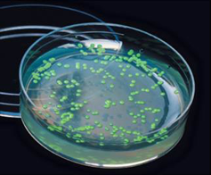
GFP Example
This example comes from a class of mine.
We measured gene expression using green fluorescent protein. This was pilot data to test the effect of a “photomultiplier” setting.
This shows how to handle multiple predictors using:
interaction fill,
facets, which allow alignment of equivalent plots.
It also shows:
progressive construction and decoration of plots,
management of devices (reminder).

Slide 63
Facets (GFP Example)
Do it yourself:
> gfp <- read.csv("gfp_test_data.csv")
> pdf(file="GFP_bar.pdf", 8, 16) ↵
> basic <- ggplot(gfp, aes(x=factor(time), y=fluor, fill=interaction(ARA, ethanol))) ↵
> basic <- basic + geom_bar(colour="black", stat="identity", position="dodge") ↵
> basic <- basic + geom_text(aes(label=fluor), vjust=1.5, colour="white", position=position_dodge(.9), size=2.5) ↵
> basic <- basic + facet_grid(gain~., scales="free")
basic + scale_fill_manual(values=c("royalblue", "darkorange", "maroon")) ↵
> dev.off() ↵

Slide 64
Saving in ggplot2
Do it yourself:
> ggsave("myplot.pdf") ↵
Default behaviour: saves last plot made with ggplot2
Learn more:
> ?ggsave ↵

Slide 65
Interactivity: Shiny
RStudio’s Visualisation Platform

Slide 66
Introducing Shiny
Do it yourself: build serious interactivity with Shiny (from the same team as RStudio:
> install.packages("shiny") ↵
Check here for tutorial:
http://shiny.rstudio.com/tutorial/
Now to understand this package we need to understand some communication details. The users’ computers should be served only html, css, js and other components readable with a web browser. The server must understand R and Shiny code.

Slide 67
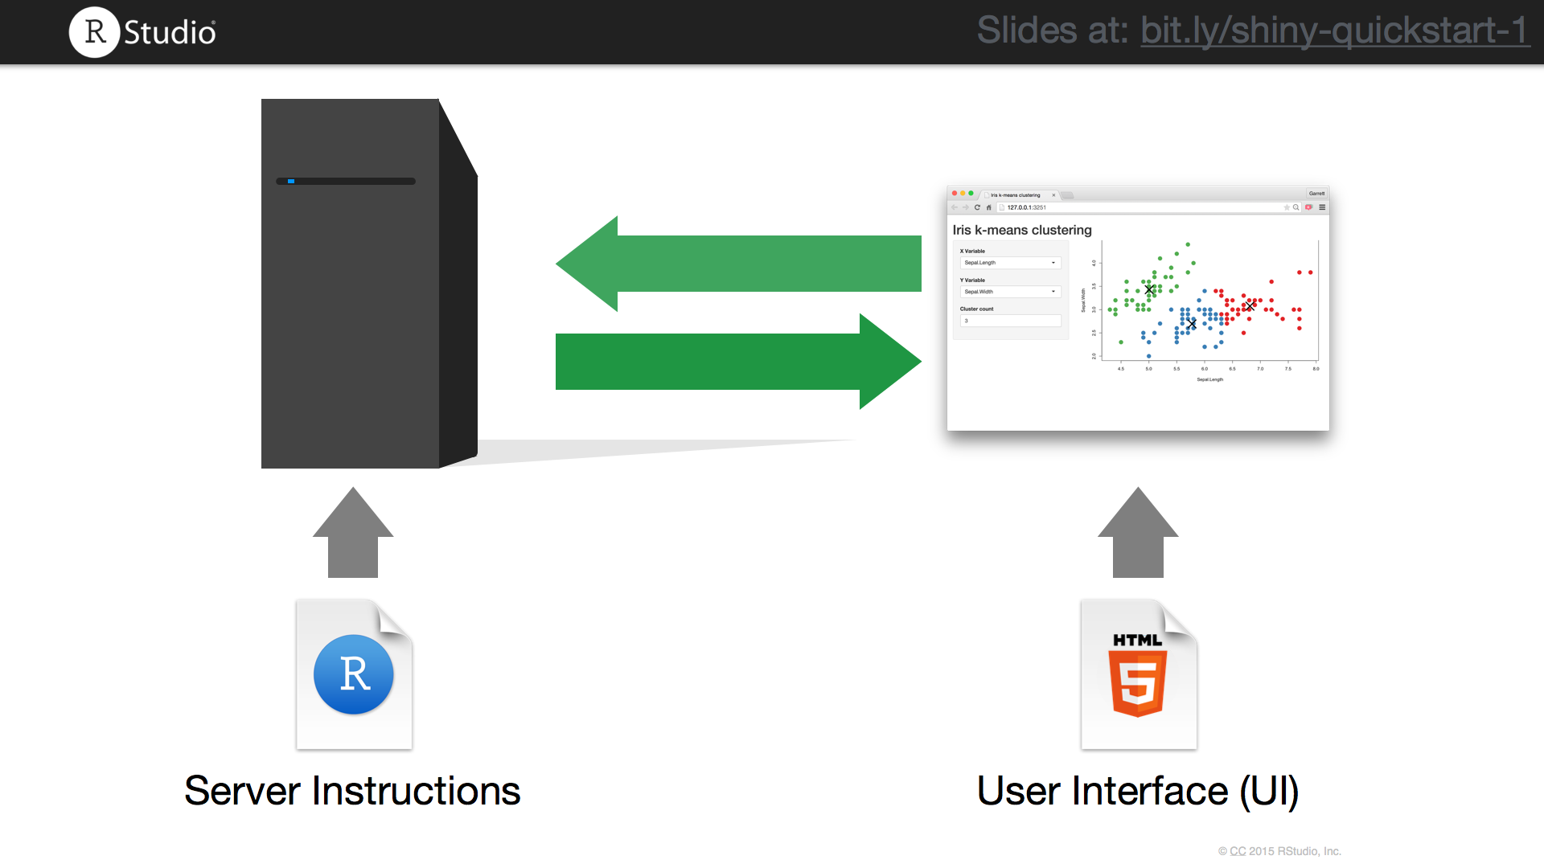

Slide 68
Where is the server?
The server can be a web-connected computer. For example visit:
https://dickinslab.shinyapps.io/shinydev/
This shows a preview of an app we will develop together. The server is located at shinyapps.io. To get us started, I recommend you sign up for their free account here:
https://www.shinyapps.io
You can make your own server:
https://www.rstudio.com/products/shiny/shiny-server/

Slide 69
Where is the server? Part 2
But to start off with, we can use the same computer for the server and for the client: the one you are using now….
Let’s start with an example.
Load shiny_ex1.R into RStudio and follow my cues to run the app. The app can be run in a separate window, in the viewer pane or externally (in your web browser).
RStudio can also interpret html code.

Slide 70
The Shiny Template
Basic Template (no need to type):
> library(shiny) ↵
> ui <- fluidPage(
# instructions for user interface
) ↵
> server <- function(input, output) {
# R code for server to execute
} ↵
> shinyApp(ui = ui, server = server) ↵

Slide 71
shiny_ex2.R
This shows how aspects of a hist() plot can be made responsive with shiny.
We will discuss this example.
See the shiny tutorial to develop more enhanced means of controlling interactivity.

Slide 72
Vision Example (with ggplot2)
This dataset is my prescription change over time. This will introduce time series data.
Do it yourself: start by recreating an object we used before:
> optics <- read.csv('prescription.csv') ↵
> optics ↵
But there’s a problem with the date variable/vector - it is a factor:
> str(optics$date) ↵
Correcting:
> optics$date <- as.Date(optics$date, format="%d/%m/%Y") ↵

Slide 73
Plotting My Vision
Now we can plot these data:
Do it yourself: start by recreating an object we used before:
> ggplot(optics, aes(x=date, y=axis, group=eye, fill=eye)) +
> geom_bar(stat="identity", position="dodge", colour="black") +
> scale_fill_manual(values=c("mistyrose", "lightblue")) ↵
Try deleting options. Change the dependent variable. What happens when you treat “date” as a factor?
But wouldn’t it be nice to choose the dependent variable? Let’s look at app.R.

Slide 74
Learning More about Shiny
The shiny web page contains a great and detailed tutorial here:
https://www.rstudio.com/products/shiny/
A gallery of inspiring interactive visualisations is maintained here:
http://shiny.rstudio.com/gallery/
And if you’re interested in dashboards for your organisation:
https://rstudio.github.io/shinydashboard/

Slide 75
Extras

Slide 76
Follow my Advanced Tutorials
Within the render-master folder I have two folders showing more advanced data analysis methods. These are written in jupyter notebooks.
If you don’t know about jupyter you can open them using my Github as follows:
Heatmap Advanced Example
setwd('heatmap')
Visit: https://github.com/tethig/render/blob/master/heatmap/Make_Heatmap.ipynb
Time Series Advanced Example (my heart rate data!)
setwd(’time_series')
Visit: https://github.com/tethig/render/blob/master/time_series/Make_TS_Plot.ipynb

Slide 77
Extra References
To understand the tidyverse:
http://www.tidyverse.org
http://r4ds.had.co.nz
http://www.business-science.io/timeseries-analysis/2017/07/02/tidy-timeseries-analysis.html
General References:
http://www.r-bloggers.com
http://stackoverflow.com
http://www.datasciencecentral.com
My website:
https://bendickins.net

Slide 78
Time to plot your own data
enjoy!

